Slide 1
CompSci 190: A/B Testing
Jeff Forbes
November 12, 2018

Slide 2
Project: Making a Notebook
Go to https://jupyterhub.cs.duke.edu
Make a folder (if desired)
Create a new Python 3 Notebook
Copy preamble code from any previous notebook
Refer to the Markdown Cheatsheet for how to add links, lists,headers, etc.
Upload data as CSV in the same directory as notebook

Slide 3

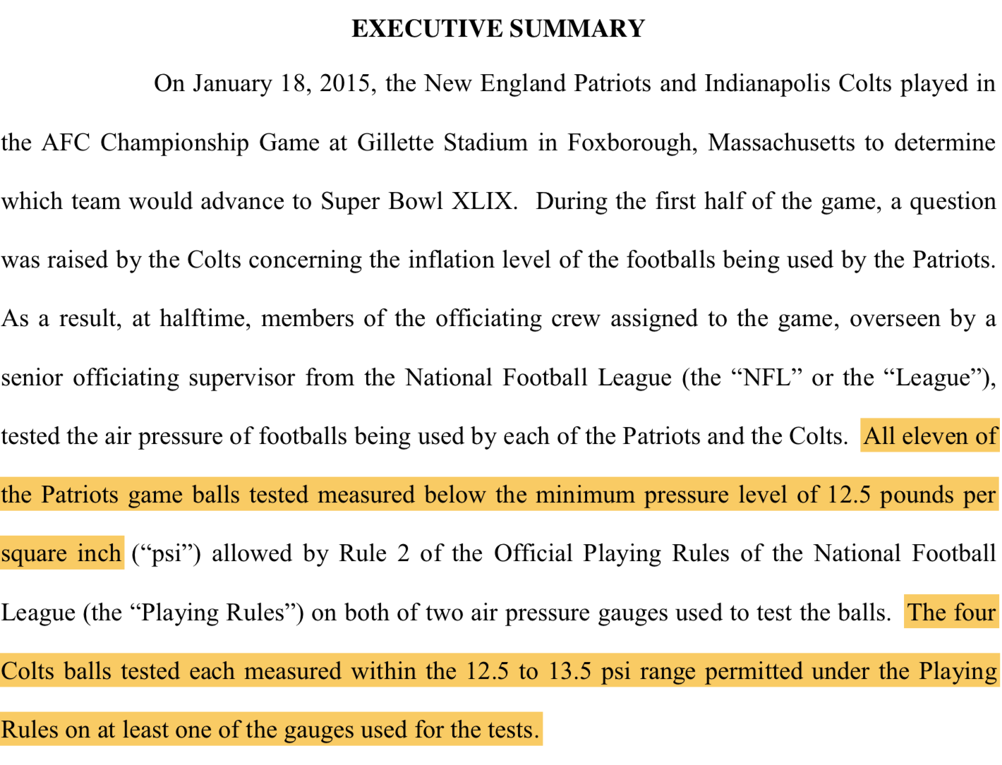
Deflategate!

Slide 4
A/B Testing
Two random samples:
Sample A
Sample B
Question: Are they drawn from the same underlying distribution?
Answer by A/B testing

Slide 5
The Hypotheses
Null:
The two samples are drawn from the same underlying population distribution; they look like two random draws from the same set.
Alternative:
The samples are drawn from different distributions; they don’t look like random draws from the same set.

Slide 6
Permutation Test
Null: The two samples are drawn randomly from the same underlying distribution.
If the null is true, all rearrangements of the variable values among the two samples are equally likely. So:
compute the observed test statistic
then shuffle the attribute values and recompute the statistic; repeat; compare with the observed statistic

Slide 7
Deflategate
Null: Each group is like a sample drawn at random without replacement from all 15 footballs.
Alternative: The Patriots’ values are too low for them to look like a random sample from the 15 balls.
Test Statistic: Colts’ average - Patriots’ average
P-value direction: ?

Slide 8
Causality
Use Randomized Control Experiments to establish causality
Sample A: control group
Sample B: treatment group
If the treatment and control groups are selected at random, then you can make causal conclusions.
Any difference in outcomes between the two groups could be due to
chance
the treatment
(Demo)

Slide 9
Botox for Back Pain!
31 patients
16 injected with Botulinim toxin A
15 injected with Saline (placebo)
Null: Distribution of 31 potential control scores is the same as the distribution of all 31 potential treatment scores
Alternative: Distribution of 31 potential control scores is different from the distribution of all 31 potential treatment scores
Test Statistic: Distance between the two proportions of relief in each group
| control proportion – treatment proportion |

Slide 10
Computing Percentiles
The 80th percentile is the value in a set that is at least as large as 80% of the elements in the set
For s = [1, 7, 3, 9, 5], percentile(80, s) is 7
The 80th percentile is ordered element 4: (80/100) * 5
Percentile
Size of set
For a percentile that does not exactly correspond to an element, take the next greater element instead

Slide 11
The percentile Function
The pth percentile is the value in a set that is at least as large as p% of the elements in the set
Function in the datascience module:
percentile(p, values)
p is between 0 and 100
Returns the pth percentile of the array
http://bit.ly/FoDS-f18-1112

Slide 12
Smoking and Birth Weights
Measured the birth weights of many babies and whether the mom smoked.
Null: The distribution of birth weights is the same for both smoker and non-smoker moms.
How to simulate the distribution of the test statistic, if the null hypothesis is true?

Slide 13
Hypothesis Test
Null: The distribution of birth weights is the same for both smoker and non-smoker moms.
If the null is true, we can model each birth as:
randomly choose a birth weight
randomly choose whether the mom is a smoker or non-smoker
How do we know the distribution of birth weights?

